Slide 1
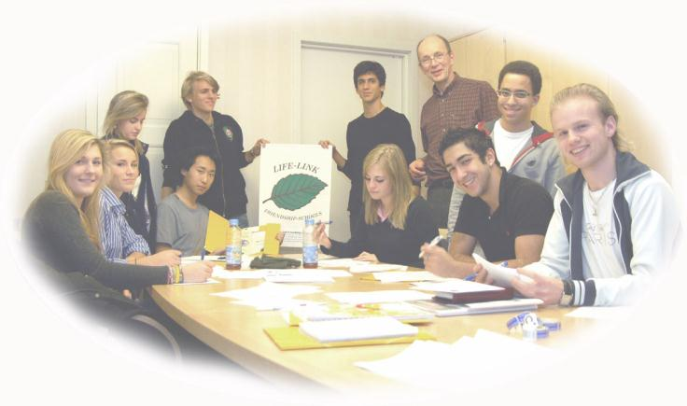
ARICA-WATER
WATER FOR LIFE 2009
A LIFE-LINK FRIENDSHIP SCHOOLS AND UNESCO ASPNET PROGRAM
Arica-Chile 2010-2014
Doctor Hans Levander and students

Slide 2
April 2010
:Coordinators Gladys Hernándezand Patricio Tudela
ESCUELA D-4
LICEO POLITECNICO
LICEO ARTISTICO
LICEO JOVINA NARANJO
LICEO PABLO NERUDA

Slide 3
ESCUELA D-4
ARE PARTICIPATING:
THIRD GRADE OF PRIMARY
FOURTH GRADE OF PRIMARY
EIGHTH GRADE OF PRIMARY

Slide 4
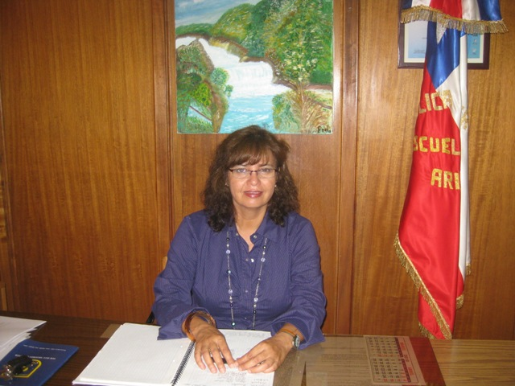
Ruth Dini Principal of Escuela D-4

Slide 5
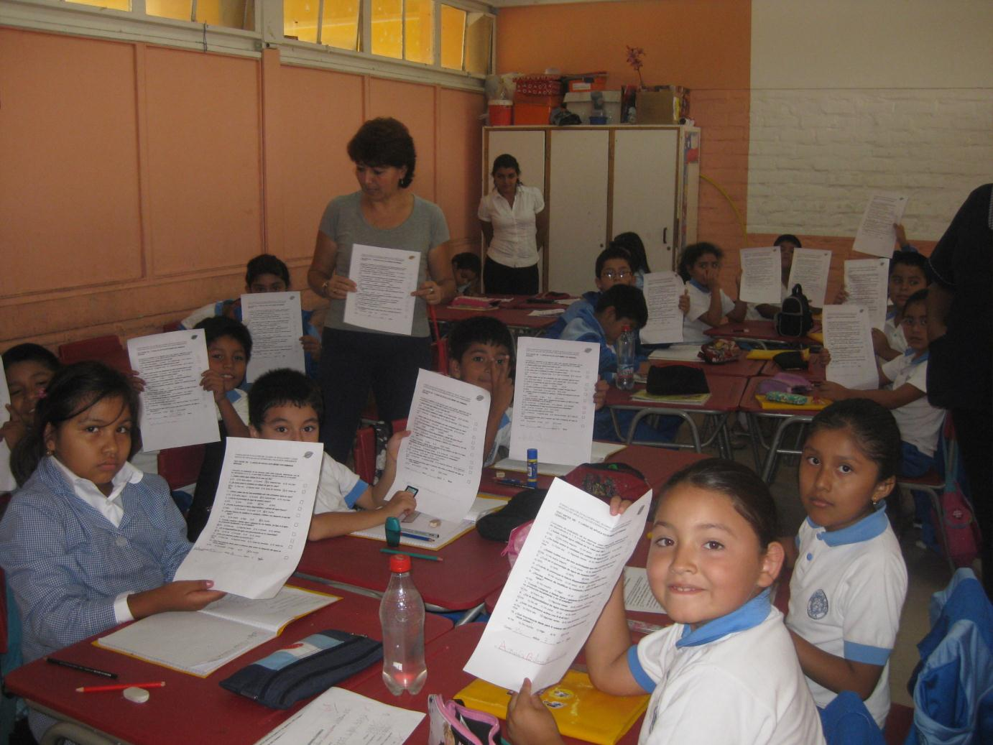

Slide 6
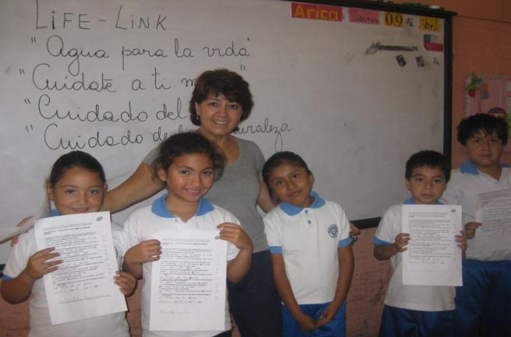
THIRD GRADE TEACHER MRS. ELENA AZUA

Slide 7
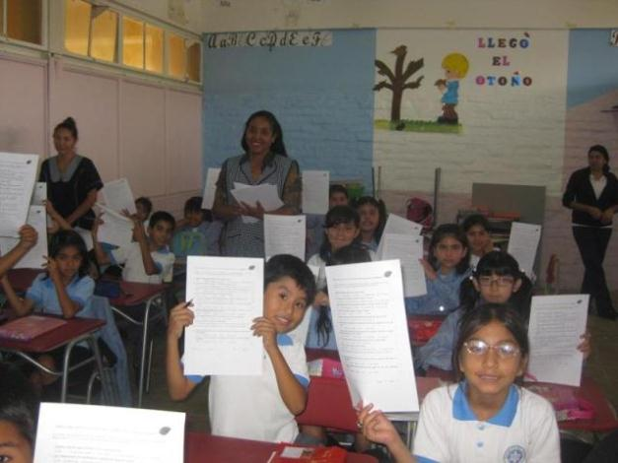
FOURTH GRADE TEACHER MRS. SANDRA DONAIRE

Slide 8
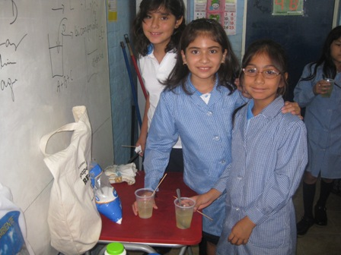
ABOUT WATER POLLUTION

Slide 9
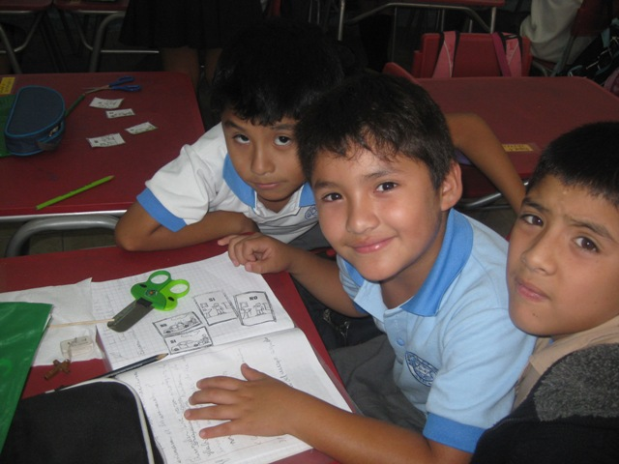
LEARNING ABOUT THE CARE AND SAVING WATER

Slide 10
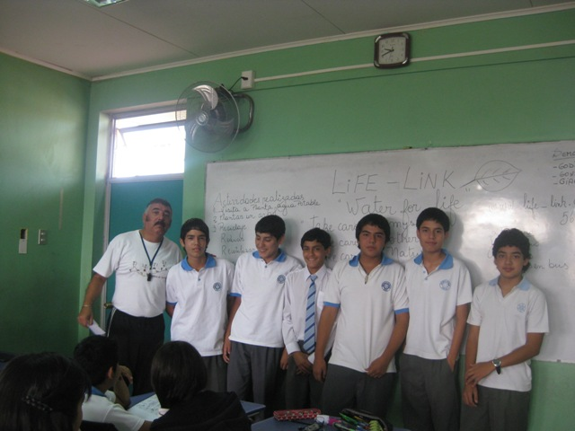
EIGHTH YEAR OF PRIMARY
(AGE 13 YEARS)
This students began with the Guide since 2007-2010-Teacher Pedro G.

Slide 11
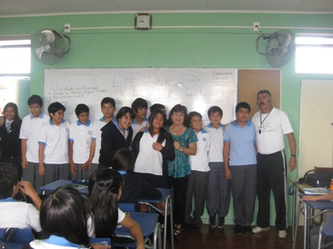
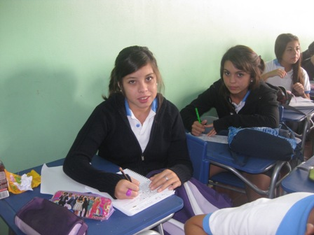
TEACHERS
PEDRO GUTIERREZ AND GLADYS HERNANDEZ

Slide 12
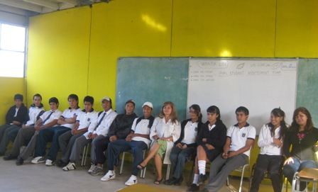
LICEO POLITECNICO
  TEACHER: GISELA SCHEUCH

Slide 13
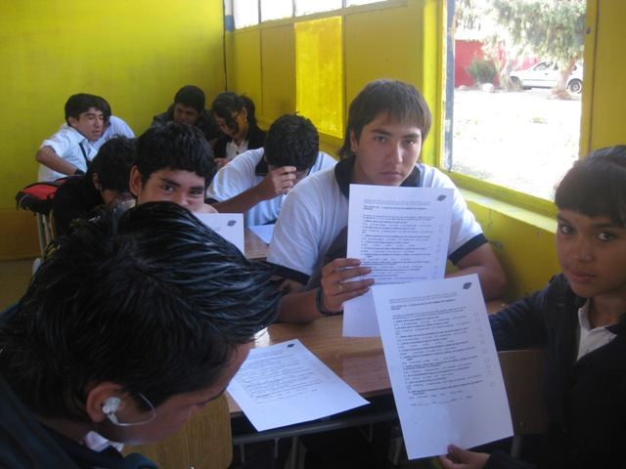
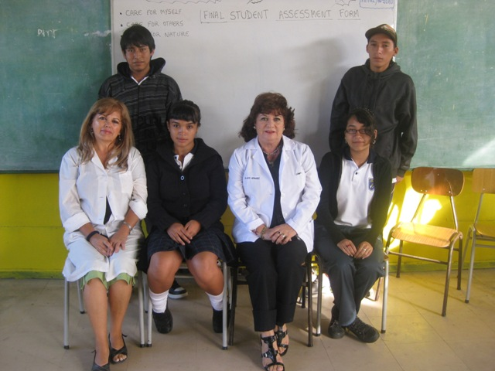
SECOND YEAR HIGH SCHOOL
AGE 16-17 YEARS
  Ms.Gisela Scheuch and Gladys Hernandez

Slide 14
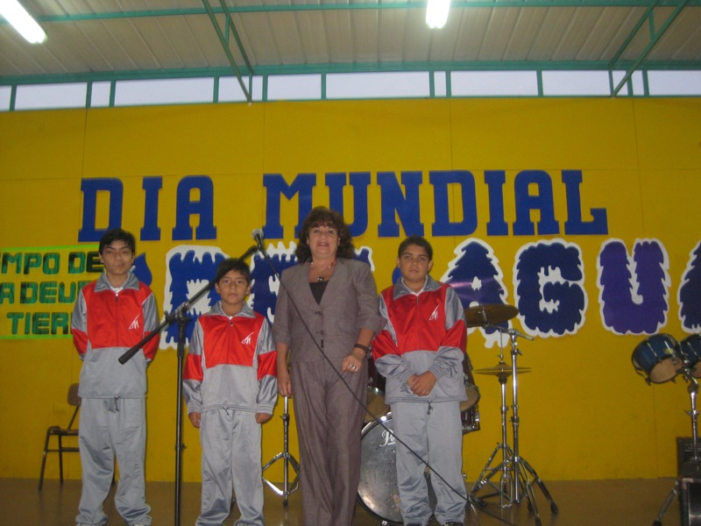
LICEO ARTISTICO
Gladys Hernández Coordinator Life-link

Slide 15
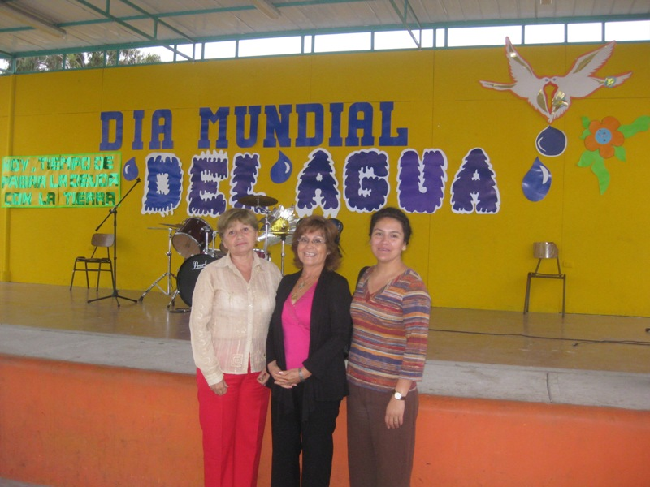
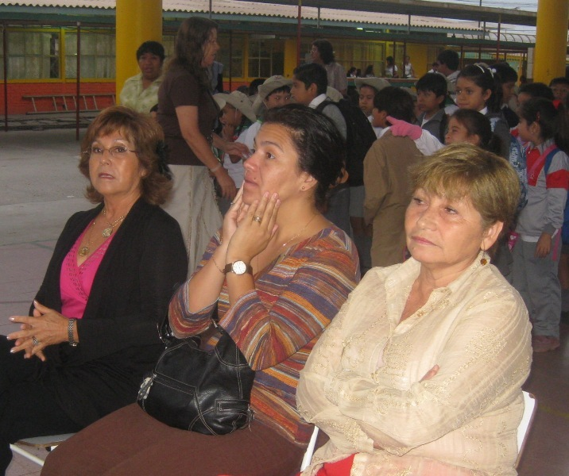
Ms. Mónica Piña of CONAMA (National Environmental Commission)Ms.Jennifer Alvarez Principal, Ms. Ana Soto
Educational Boss
Authorities

Slide 16
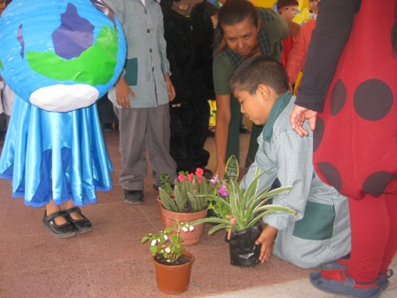
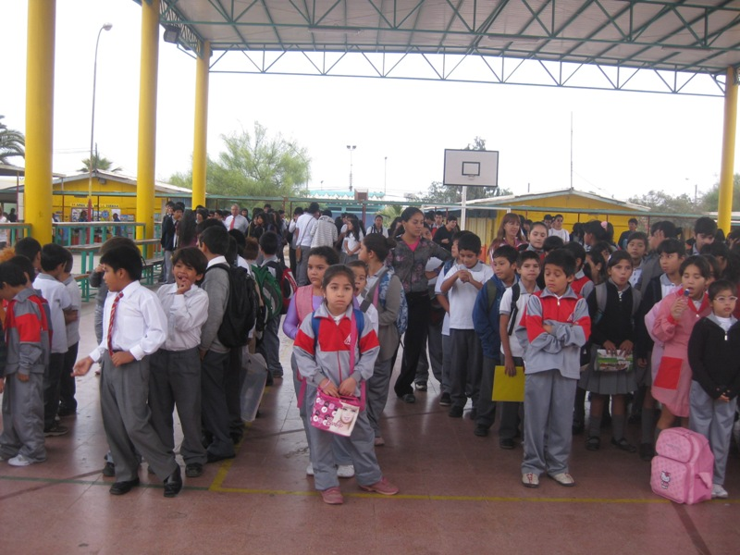
LICEO ARTISTICO

Slide 17
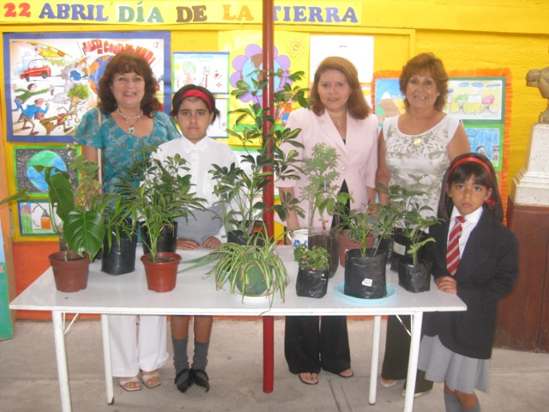
LICEO ARTISTICO

Slide 18
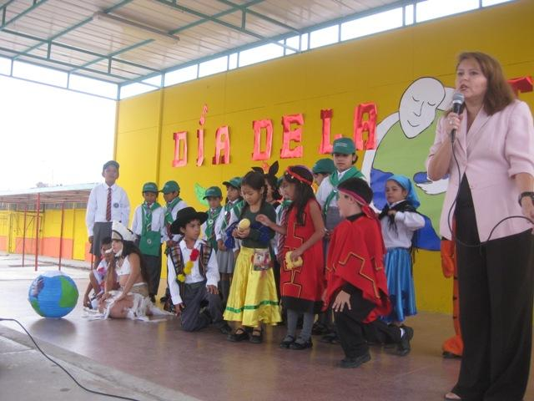
Liceo Artistico
TEACHER .Ms. Solange Araya

Slide 19
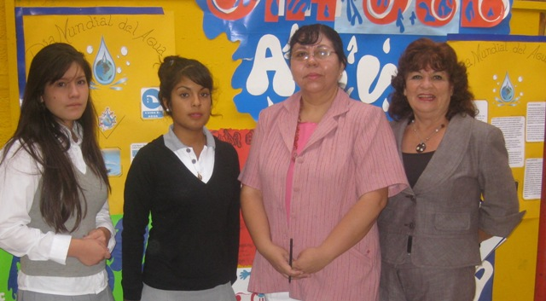
Teacher: Ms. Elizabeth Leiva
Second year of high school- Students 16 years old.

Slide 20
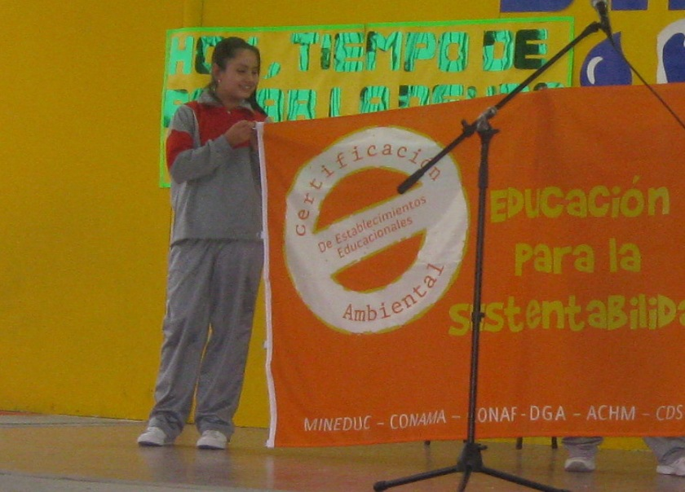
LICEO JOVINA NARANJO Teacher: Lucy Fernández _
High School
Students age 16 year old

Slide 21
ACTIVITIES CARRIED OUT BY STUDENTS ARICA-CHILE

Slide 22
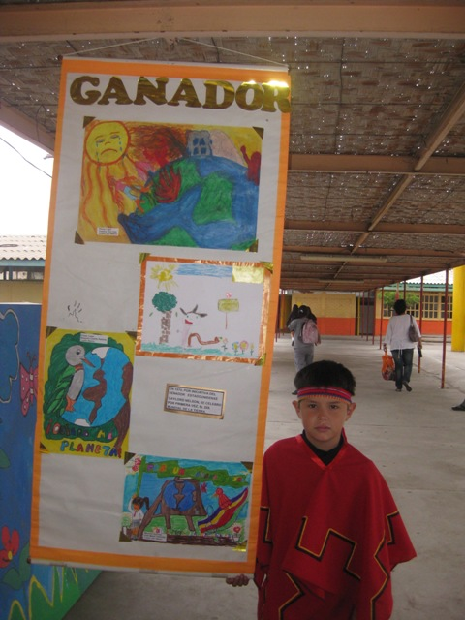
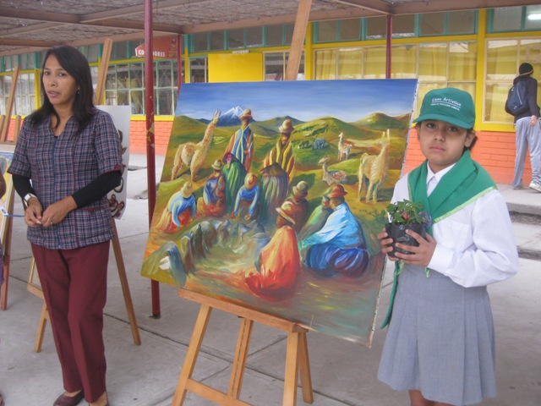
Exhibition

Slide 23
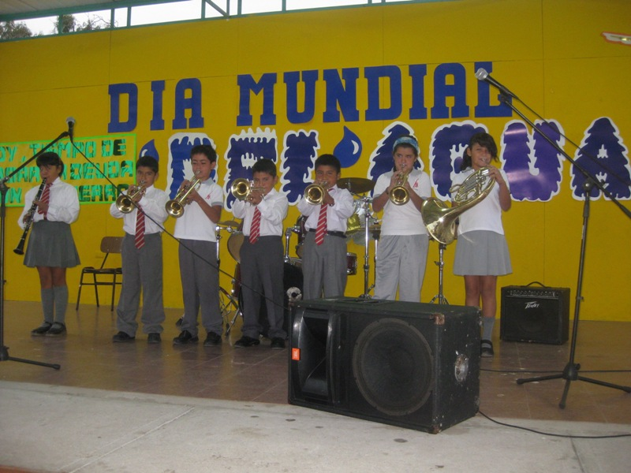
MUSIC

Slide 24
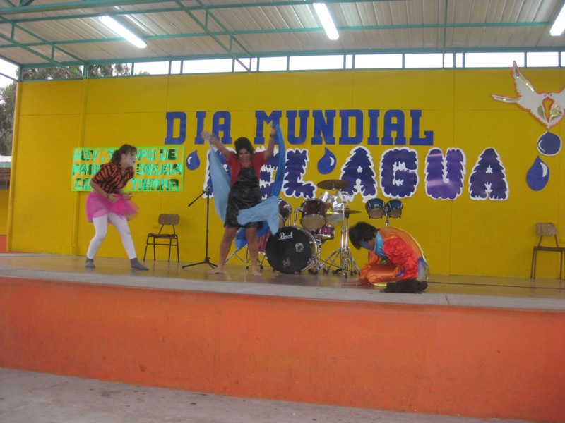
PLAY (THEATRE) ABOUT WATER
Students 16 year old.

Slide 25
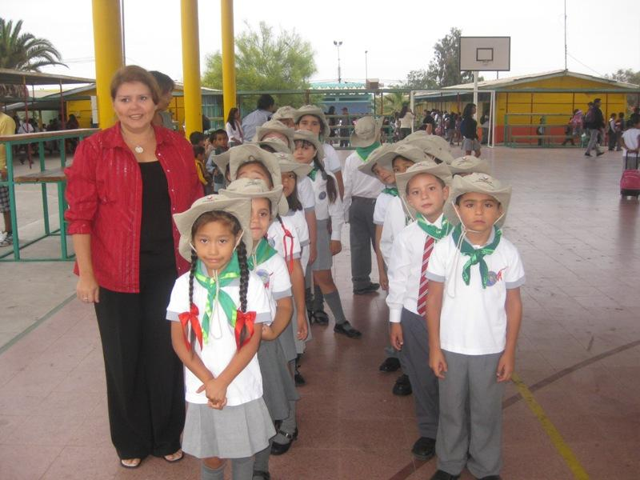
DEPARTURES TO VISIT

Slide 26
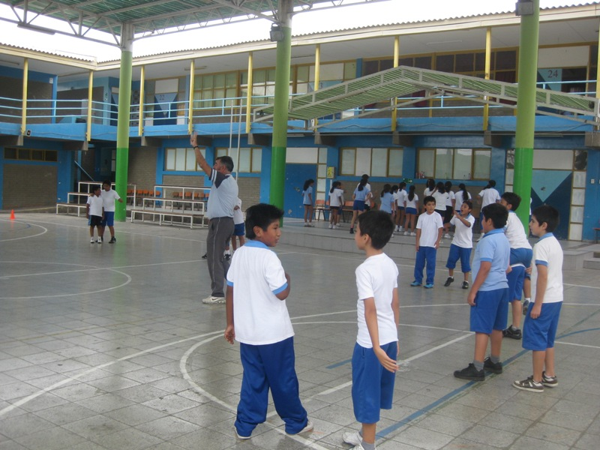
Activities

Slide 27
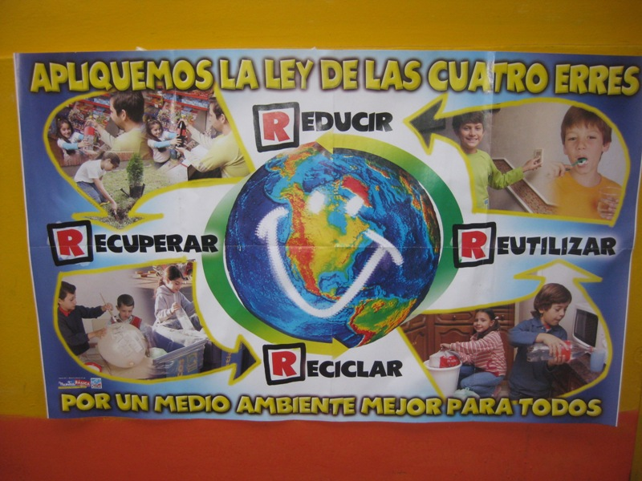
POSTERS

Slide 28
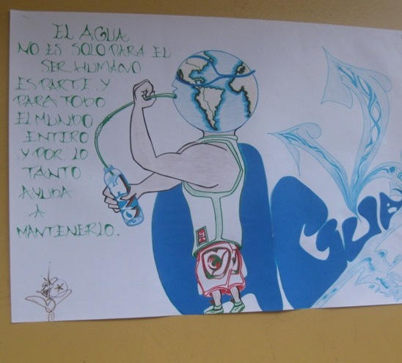
Posters

Slide 29
The Teachers·s guideline has been successful in our Schools ( inside curriculum)
We ( teachers and authorities) are sending , Congratulations and a hug to Dr. Hans Levander , who has inspired us in this important work, also an affectionate greeting to Mr. Goran Save and their collaborators.
From :
Principals, Teachers, Coordinators Life-Link and students from Arica-Chile

Slide 30
CONGRATULATIONS AND GREETINGS SENT BY :
Coordinators :Gladys H .and Patricio Tudela
Principals : Jennifer Alvarez , Maritsa Saavedra, Juan Zenteno, Ruth Dini, and Mario Vargas.
CONAMA. Ms. Mónica Piña
Teachers: Ana Soto, Pedro Gutierrez, Lucy Fernández, Elizabeth Leiva, Solange Araya,Gisela Scheuch, Elena Azúa, Sandra Donaire, María Huerta.

